Slide 1

Citation Distortion Through Graph Theory
Davide Aureli: 1651051
Alfonso D’Amelio: 1658170
Valerio Guarrasi: 1643257
Daniele Mocavini: 1475062
Federico Siciliano: 1604124

Slide 2
Introduction
We have dealt
"Challenges related to output measures and possible approaches"
Focusing our attention on publications and citations of the authors related to
Computer Science.
We will try to analyze millions of data that apparently have no relation to each other but, we can represent them through a single structure:
Graphs

Slide 3
But… what are citations?
The researchers in science
communicate new discoveries, express ideas and measure success
through publications and citations.
Citations are included in research papers for 2 main reasons:
1) to build an argument
2) to give credit to research done by others

Slide 4
citation distortion
Citations included in scientific pubblications are expected to be
relevant and comprehensive
Citation Distortion is any misrepresentation of these two features
We will try to identify and solve 2 common type of distortions:
Self-Citation:
Refers to researchers that overly citing personal works
It is usually done to artificially inflate carrier statistics.
Exchanging Citation:
Between two authors who for example have collaborated in a publication and decide to refer to each other in future even if not relevant or inherent with their future works.

Slide 5
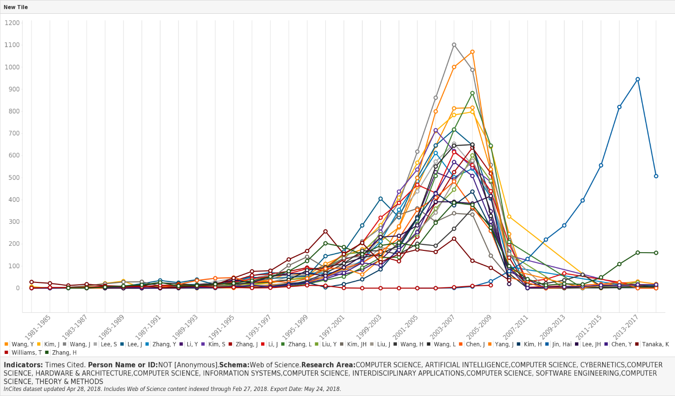
Data description
For this purpose, taking the 25 most productive authors (ordered by "number of Web of Science Documents“), we have obtained the following chart (Y: Times Cited)
The first thing we verified is the trend that the citations concerning our branch of interest have had during the last 35 years.

Slide 6
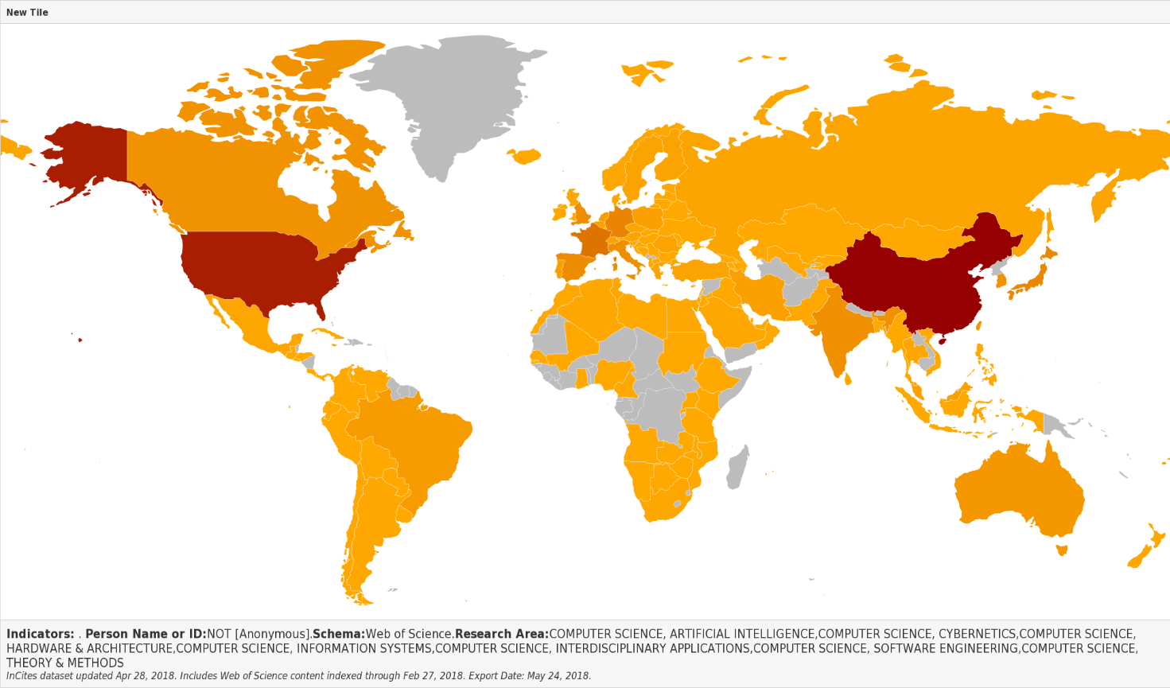
Data description
It is also interesting to note the country of origin of the most productive authors
With a strong predominance of the USA and China

Slide 7
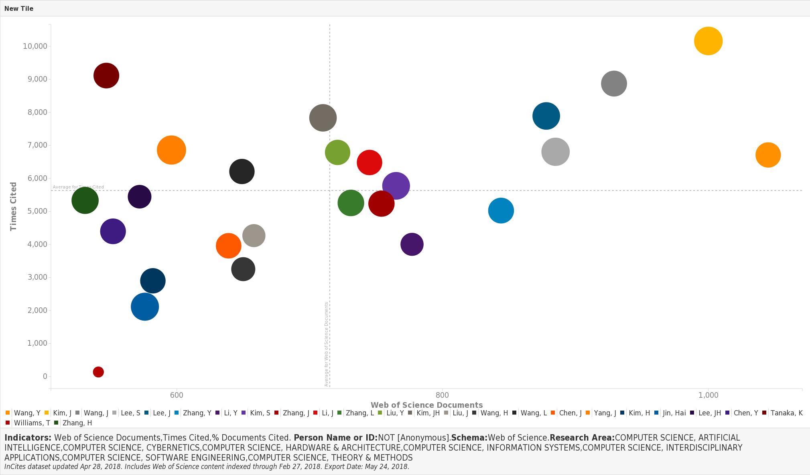
Data description
We observed the relation between the number of document published (axes X) and the number of times that the author has been cited (axes Y) (using as radius the % cited documents)
But as we will see later this data can be subject to distortion
There seems to be a trend ...

Slide 8
Visualize the relations
between
Number of time cited
and
Importance of written documents
(according to the percentage of publications in the top 1%
based on citations by category, year, and document type)

Slide 9
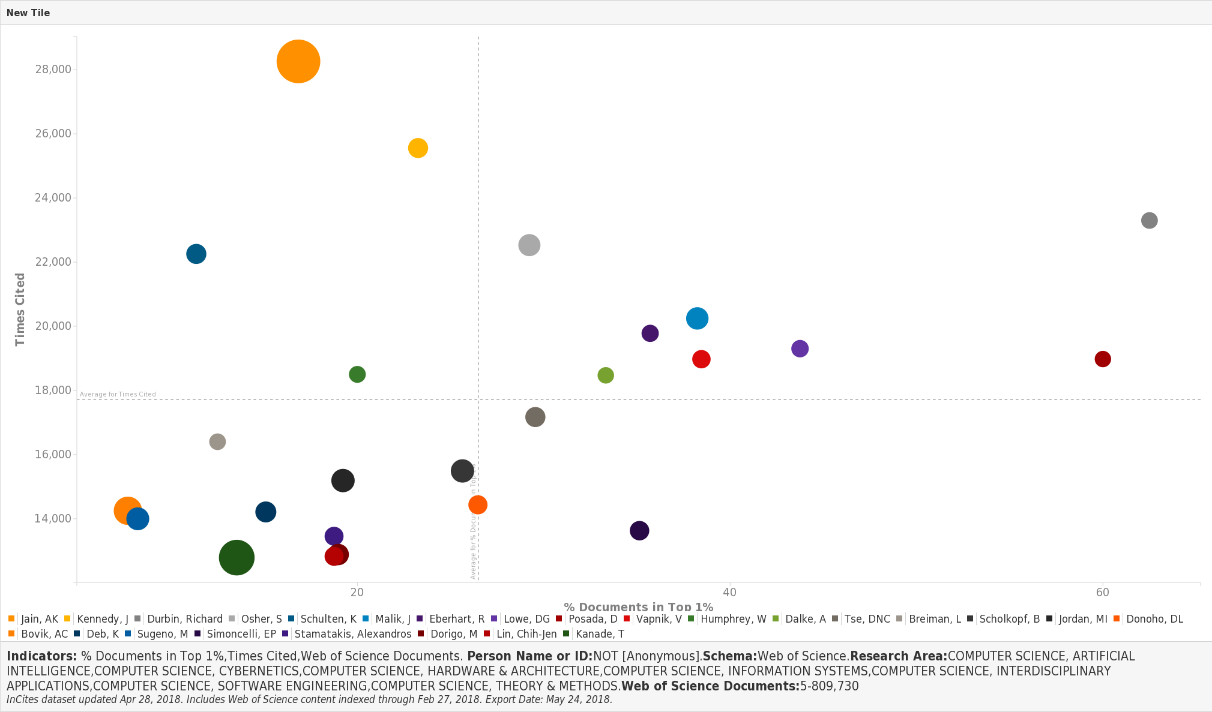
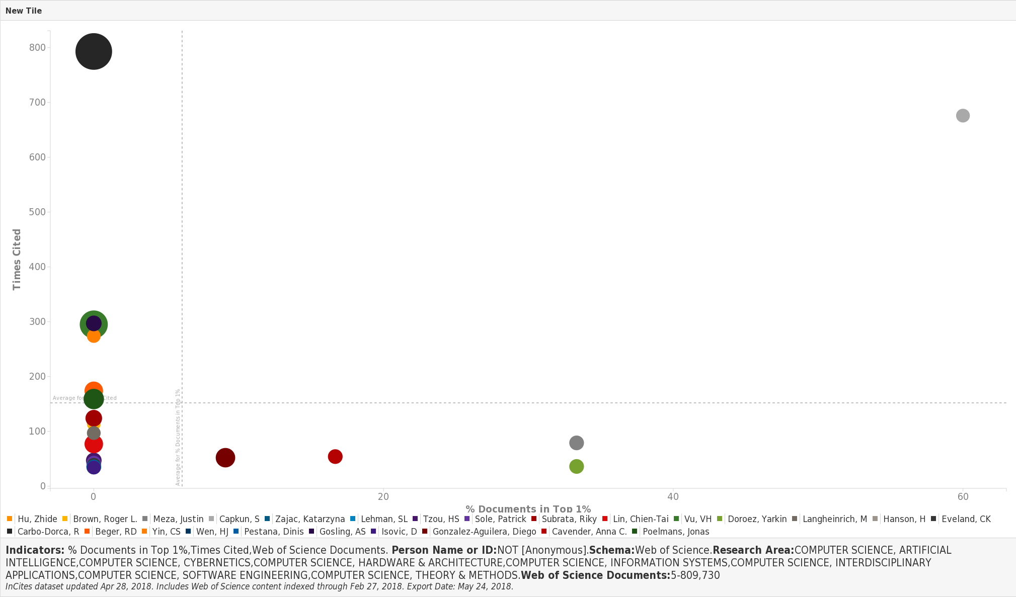
Durbin, Richard
9 documents,
100% time cited
23,847 times cited
55,56% documents in top 1%
Carbo-Dorca, R
29 documents,
100% time cited
794 times cited
0% documents in top 1%
Capkun, S
5 documents,
100% time cited
690 times cited
60% documents in top 1%
Jain, AK
286 documents,
89,51% time cited
28,541 times cited
17,13% documents in top 1%
Data ordered according to the time cited
Data ordered according to the percentage of documents cited
We can observe how only a few authors cited in percentage many times have actually written some very important documents.
Observation also highlighted by the low number of documents that have actually been written (radius) (remember that the top productive have more then 1000 publications).

Slide 10
Data integration
1. Scraping from Incites (http://incites.thomsonreuters.com/#/signin)
2. Merging this data with the DBLP dataset of Computer Scientists
What is DBLP?
DBLP is a computer science bibliography website. Starting in 1993 at the University of Trier, Germany, it grew from a small collection of HTML files and became an organization hosting a database and logic programming bibliography site. DBLP listed more than 3.66 million journal articles, conference papers, and other publications on computer. All important journals on computer science are tracked. Proceedings papers of many conferences are also tracked.

Slide 11
Data STRUCTURE
The python objects that we created have these structures:
CONFERENCES :
{”id conf int” :
{”conf”: id conf,
”title”: title conf,
”pub_int”: [ id pub_int_1, id pub_int_2, id pub_int_3, .....]}}
AUTHORS :
{”aut_id” :
{ ”name”: author name,
”pub”:[ pub_int_1, pub_int_2, pub_int_3,....]}}
PUBLICATIONS :
{”id pub int” :
{”pub”:id_pub,
”authors”:[aut _id _1, aut _id_2, aut_id_3,...]}}
The JSON file that we created had this structure:
[{"authors": [
{"author": first name and last name of author1, "author_id": author1 id},
{"author": first name and last name of author2, "author_id": author2 id},…],
"id_conference": conference id name,
"id_conference_int": conference id,
"id_publication": publication id name,
"id_publication_int": publication id,
"title": title of the publication}, …

Slide 12
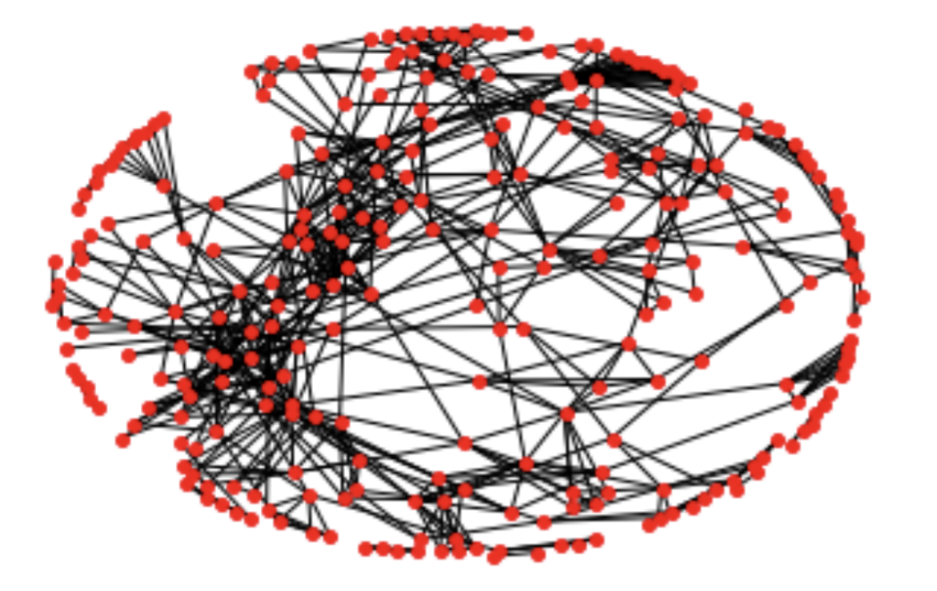
Graph #1
Nodes: authors
Edges: publications
Edge weigth = Jaccard Distance

Slide 13

Networkx
NetworkX is a Python language software package for the creation, manipulation, and study of the structure, dynamics, and function of complex networks. With NetworkX you can load and store networks in standard and nonstandard data formats, generate many types of random and classic networks, analyze network structure, build network models, design new network algorithms, draw networks, and much more. NetworkX provides data structures for graphs (or networks) along with graph algorithms, generators, and drawing tools.

Slide 14

What is a graph?
A graph is an ordered pair G=(V,E) where,
V is the vertex set whose elements are the vertices, or nodes of the graph.
E is the edge set whose elements are the edges, or connections between vertices, of the graph.
If the graph is undirected,
individual edges are unordered pairs {u,v} where u and v are vertices in V.
If the graph is directed,
edges are ordered pairs (u,v).
The order of a graph is the number of vertices in it, usually denoted |G| or n. The size of a graph is the number of edges in it, denoted |E| or m.

Slide 15

Jaccard
The Jaccard index, also known as Intersection over Union and the Jaccard similarity coefficient, is a statistic used for comparing the similarity and diversity of sample sets.
$$J\left(A,B\right)=\frac{|A∩B|}{|A∪B|}=\frac{|A∩B|}{\left|A\right|+\left|B\right|−|A∩B|}$$
$0≤J(A,B)≤1$
The Jaccard distance, which measures dissimilarity between sample sets, is complementary to the Jaccard coefficient and is obtained by subtracting the Jaccard coefficient from 1.
$$d_{J}\left(A,B\right)=1−J\left(A,B\right)=\frac{\left|A∪B\right|−|A∩B|}{|A∪B|}$$

Slide 16

Some statistics...
We wrote a Python software that a given a conference in input, returns the subgraph induced by the set of authors who published at the input conference at least once.
Once we have the graph, we computed some centralities measures
We want to compute some statistics and visualizations
On our data

Slide 17

Centrality measures
In graph theory and network analysis, indicators of centrality identify the most important vertices within a graph.
1. Degree Centrality $C_{D}\left(v\right)=deg(v)$
2. Closeness Centrality $C\left(u\right)=\frac{n−1}{\sum_{v=1}^{n−1}{d(v,u)}}$
3. Betweenness Centrality $C_{B}\left(v\right)=\sum_{s,t∈V}{\frac{σ(s,t|v)}{σ(s,t)}}$

Slide 18
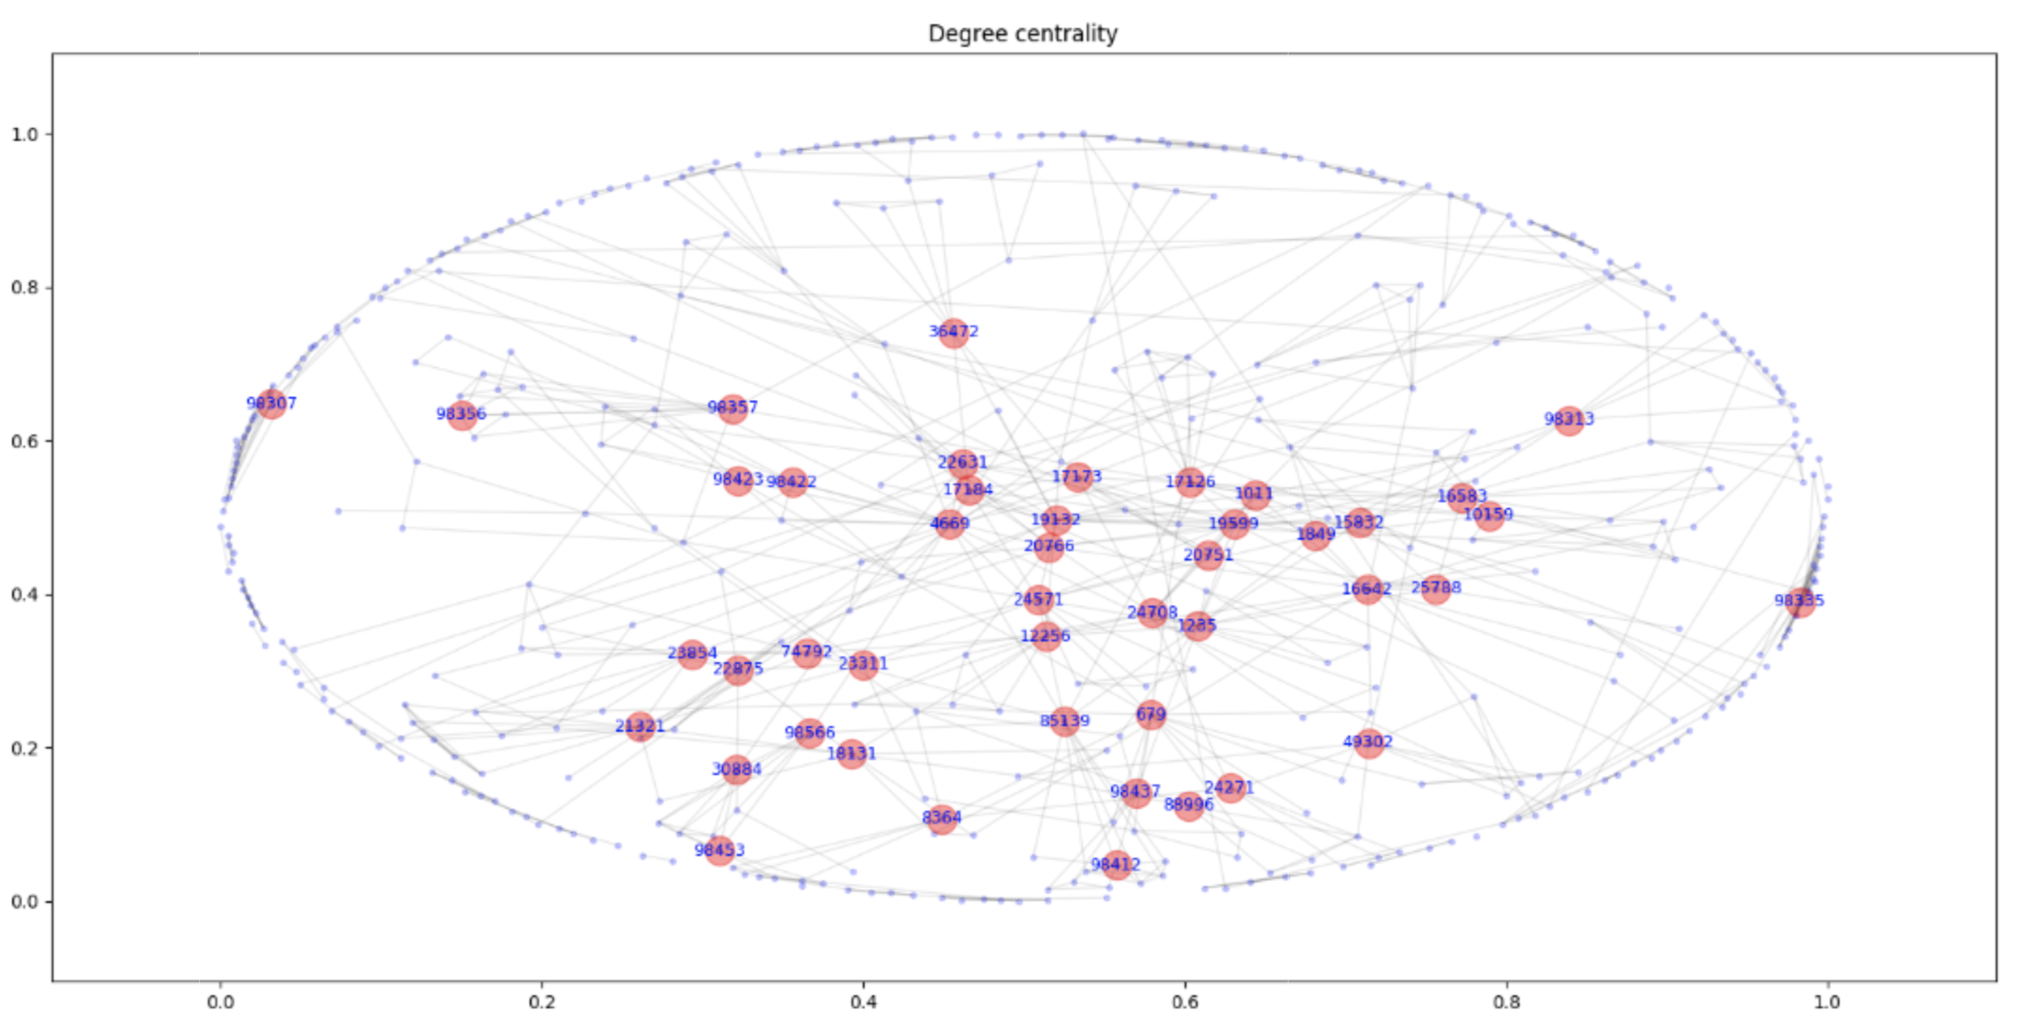

Slide 19
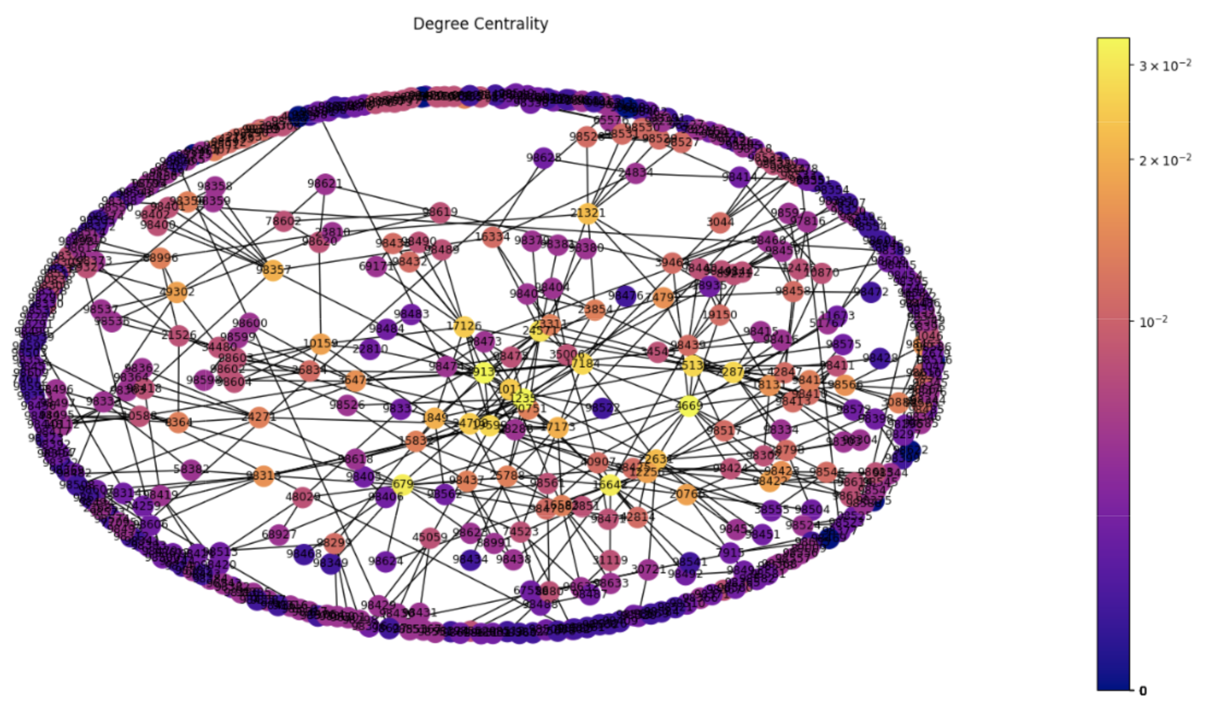
Ying Wang
id:1235

Slide 20
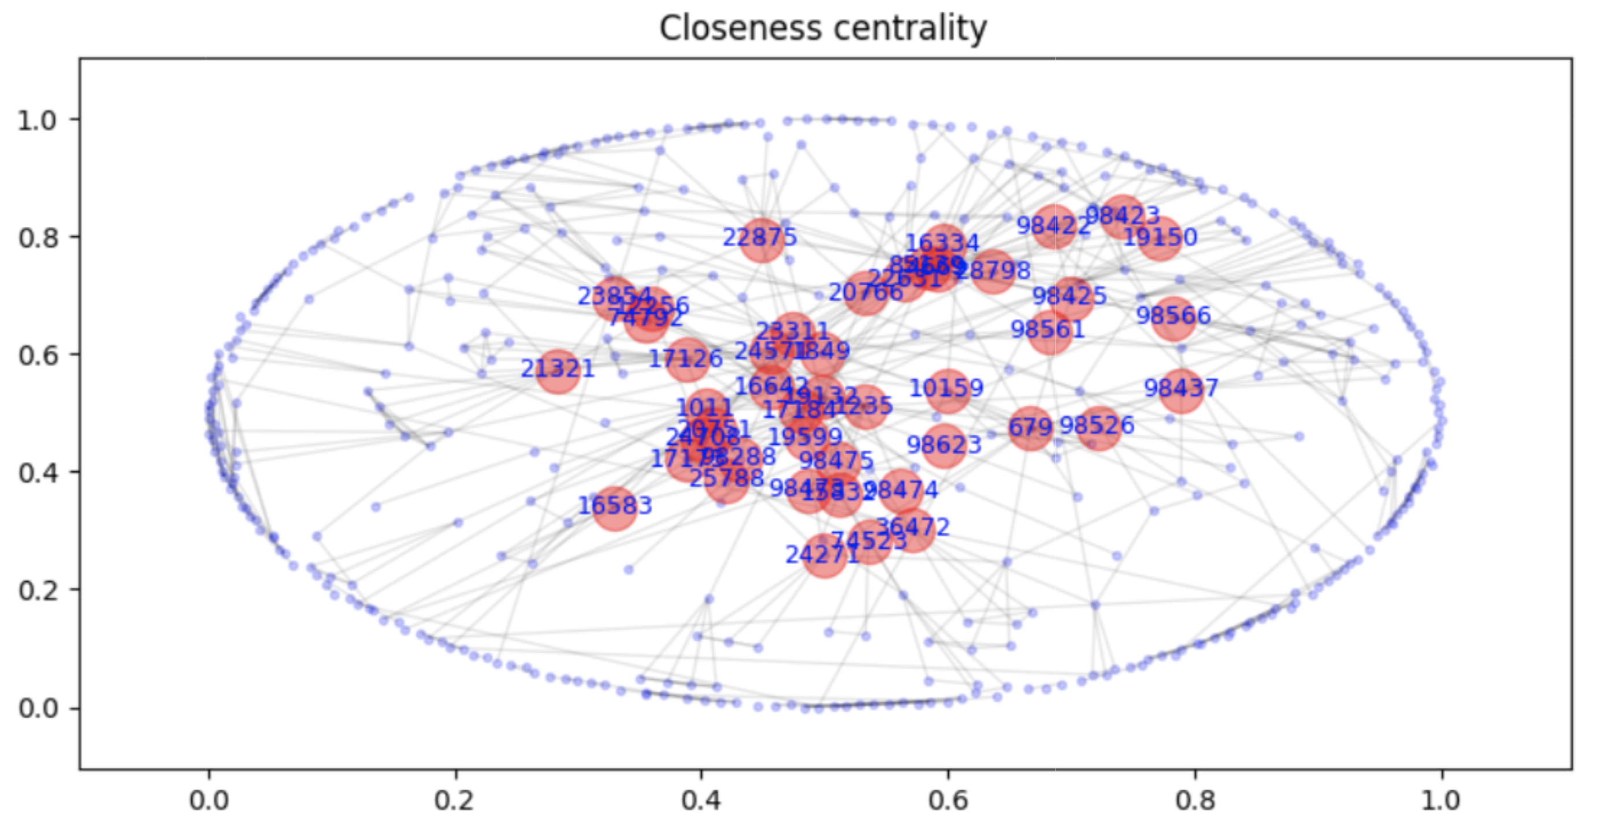

Slide 21
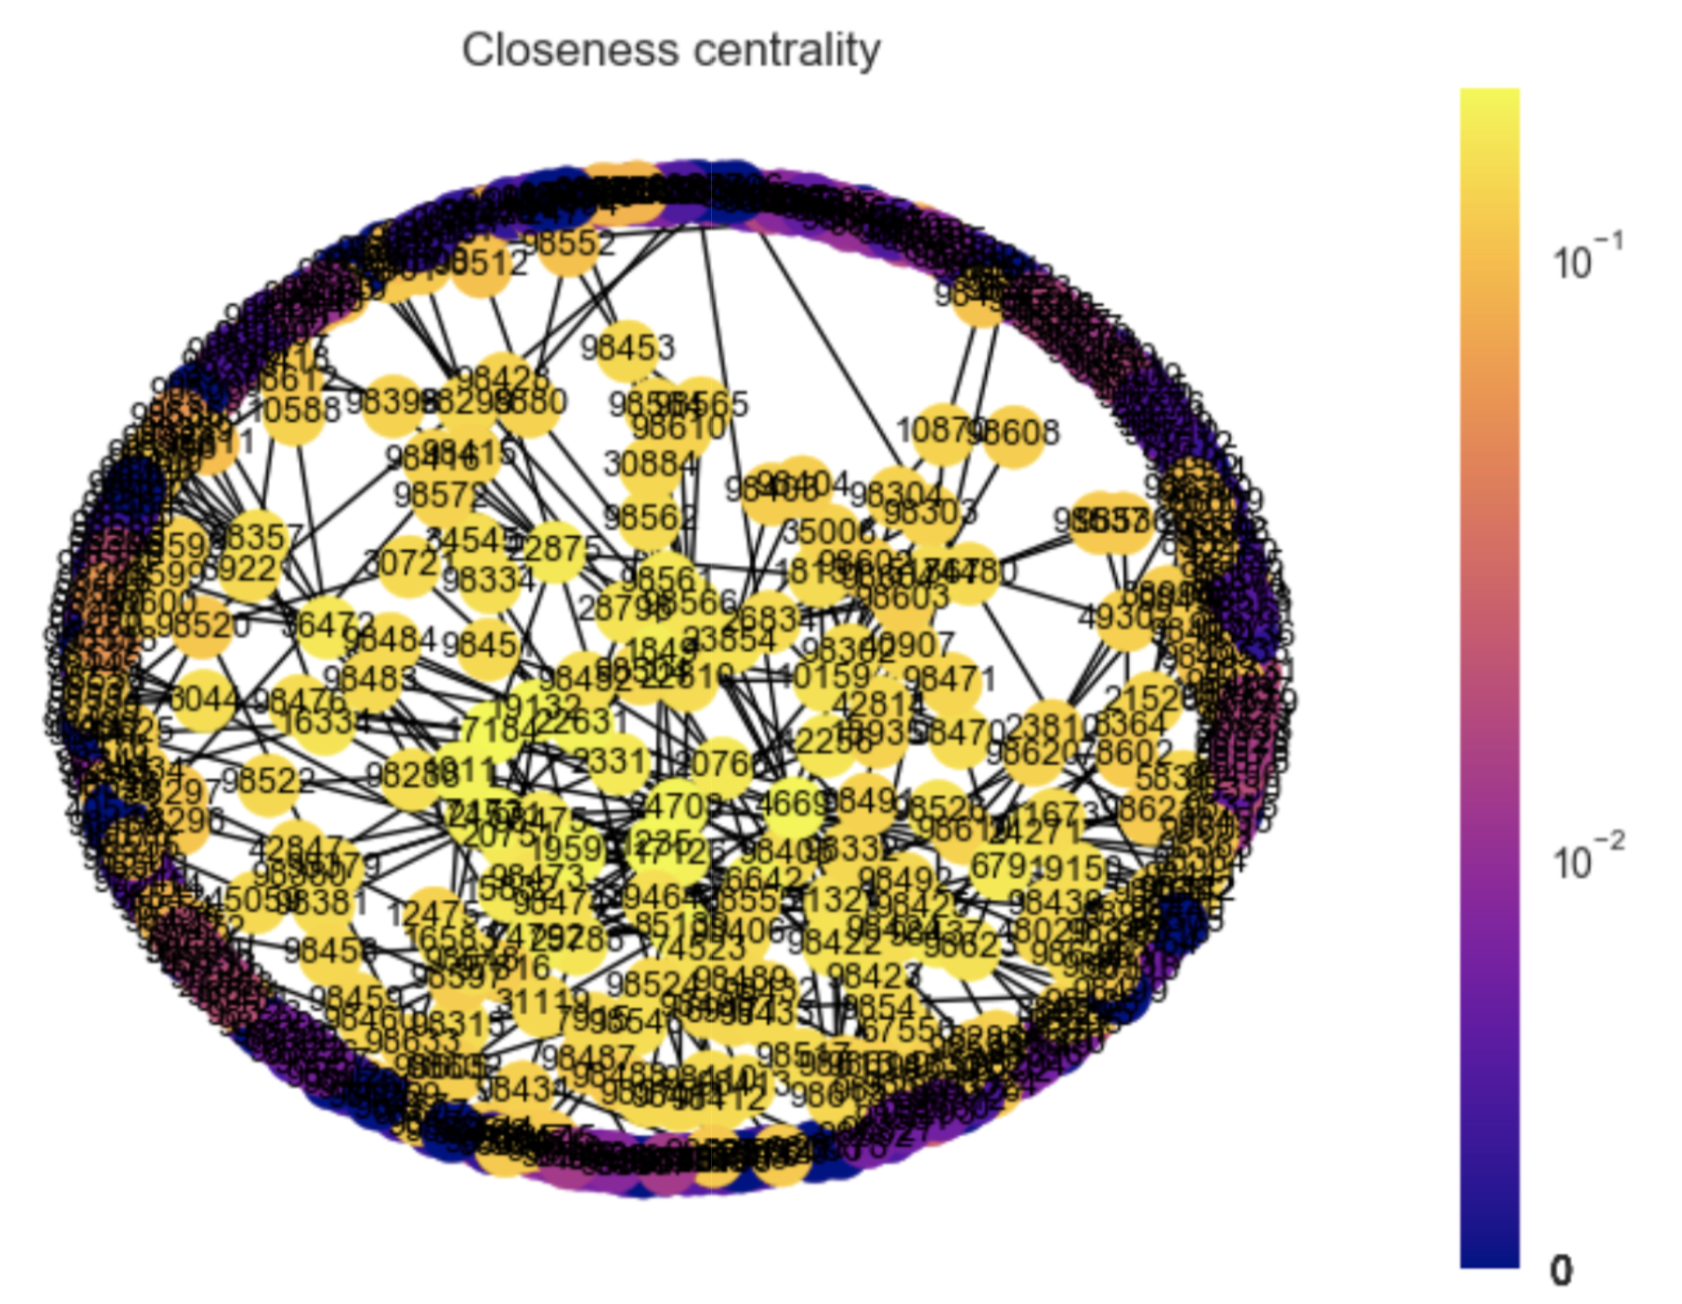
Ying Wang
id:1235

Slide 22
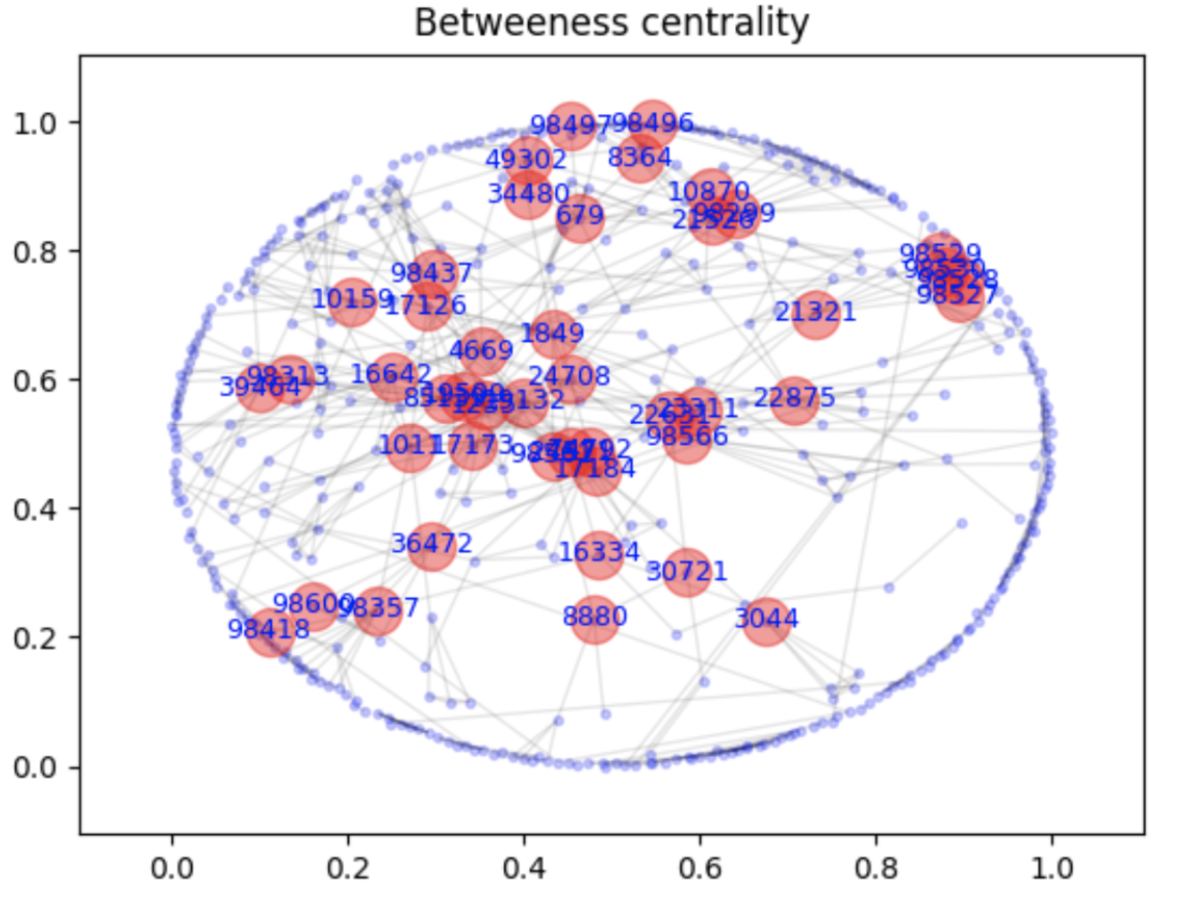

Slide 23
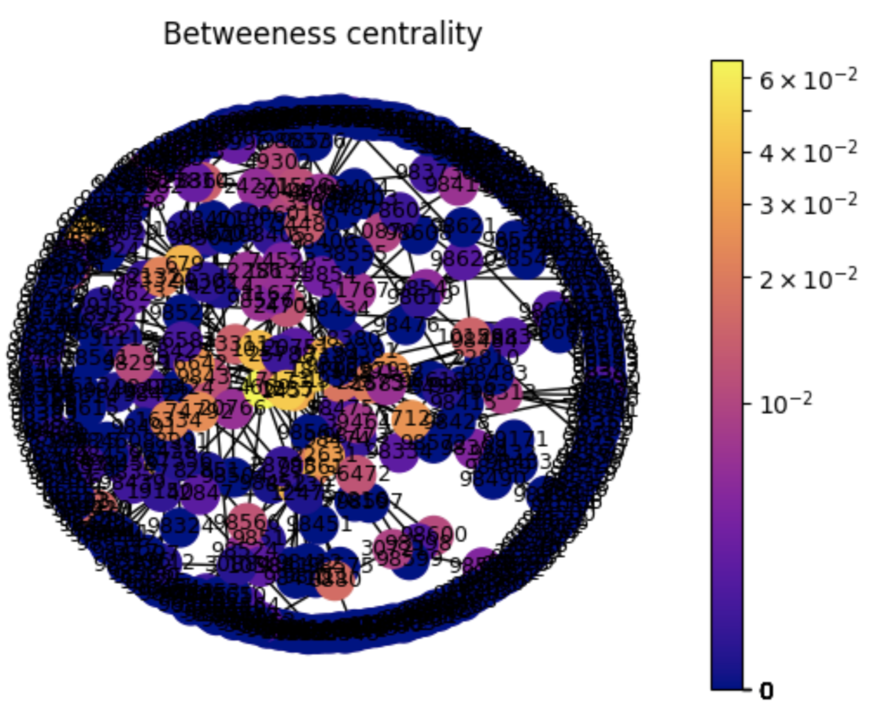
Hui Li
Id: 4669

Slide 24
Path
In graph theory, a path in a graph is a finite or infinite sequence of edges which connect a sequence of vertices which are all distinct from one another.
Shortest path problem is the problem of finding a path between two vertices (or nodes) in a graph such that the sum of the weights of its constituent edges is minimized.
Hop distance is the distance between two vertices in a graph is the number of edges in a shortest path connecting them. If there is no path connecting the two vertices, i.e., if they belong to different connected components, then conventionally the distance is defined as infinite.

Slide 25
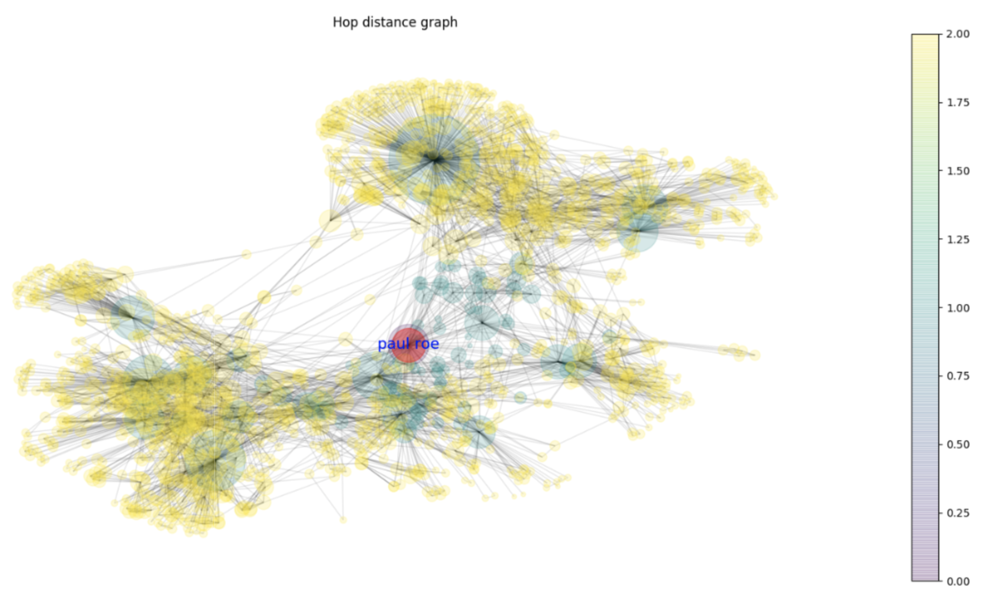
Starting point: Paul Roe
Hop 1: Green
Hop 2: Yellow
Size: # Connections

Slide 26
Path computation
We wrote a Python software that takes in input an author (id) and returns the weight of the shortest path that connects the input author with a given random node.
Then we wrote a Python software that takes in input a subset of nodes and returns, for each node of the graph, its GroupNumber, defined as follows:
GroupNumber(v) = min U∈I {ShortestPath(v,u)}
where v is a node in the graph and I is the set of input nodes.
Here we computed some generalized version of the Erdos number

Slide 27
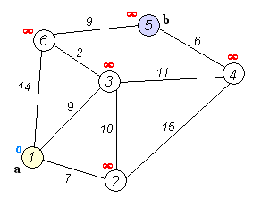
Dijkstra’s Algorithm
Dijkstra's algorithm is an algorithm for finding the shortest paths between nodes in a graph.
Mark all nodes unvisited. Create a set of all the unvisited nodes called the unvisited set.
Assign to every node a tentative distance value: set it to zero for our initial node and to infinity for all other nodes. Set the initial node as current.
For the current node, consider all of its unvisited neighbors and calculate their tentative distances through the current node.
If the destination node has been marked visited (when planning a route between two specific nodes) or if the smallest tentative distance among the nodes in the unvisited set is infinity (when planning a complete traversal
Otherwise, select the unvisited node that is marked with the smallest tentative distance, set it as the new "current node", and go back to step 3.
When we are done considering all of the neighbors of the current node, mark the current node as visited and remove it from the unvisited set.
Move to the next unvisited node with the smallest tentative distance and repeat the above steps which check neighbors and mark visited.

Slide 28
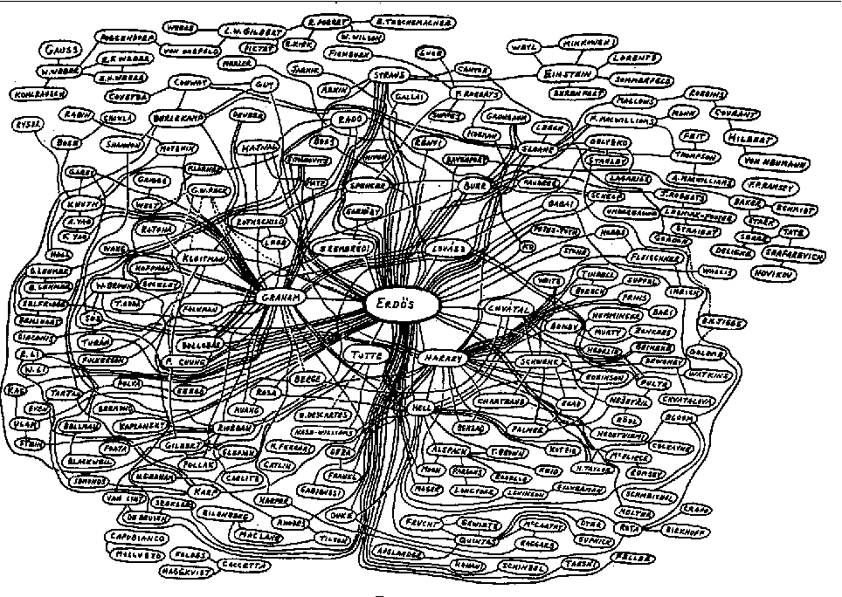
Erdos Number
The Erdős number describes the "collaborative distance" between two people.
To be assigned an Erdős number, someone must be a coauthor of a research paper with another person who has a finite Erdős number.
Paul Erdős has an Erdős number of zero. Anybody else's Erdős number is k + 1 where k is the lowest Erdős number of any coauthor.
Erdős wrote around 1,500 mathematical articles in his lifetime, mostly co-written. He had 511 direct collaborators; these are the people with Erdős number 1.
The people who have collaborated with them (but not with Erdős himself) have an Erdős number of 2, those who have collaborated with people who have an Erdős number of 2 (but not with Erdős or anyone with an Erdős number of 1) have an Erdős number of 3, and so forth. A person with no such co-authorship chain connecting to Erdős has an Erdős number of infinity (or an undefined one). Since the death of Paul Erdős, the lowest Erdős number that a new researcher can obtain is 2.

Slide 29
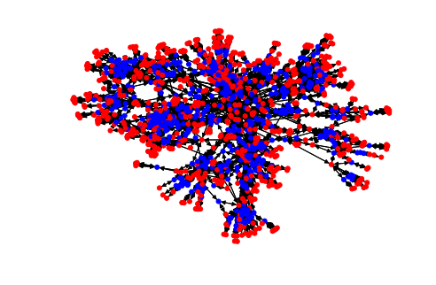
Graph #2
Red nodes: authors
Blue nodes: publications
Edges: connection between author and his publications

Slide 30
Induced subgraph
In graph theory, an induced subgraph of a graph is another graph, formed from a subset of the vertices of the graph and all of the edges connecting pairs of vertices in that subset. Formally, let G = (V, E) be any graph, and let S ⊂ V be any subset of vertices of G. Then the induced subgraph G[S] is the graph whose vertex set is S and whose edge set consists of all of the edges in E that have both endpoints in S.

Slide 31
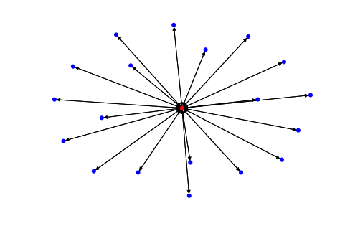
Red: author
Blue: publications
Hop Distance: 1

Slide 32
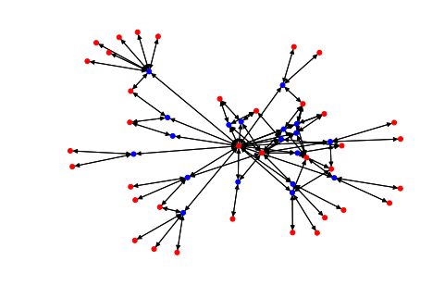
Red: authors
Blue: publications
Hop Distance: 2

Slide 33
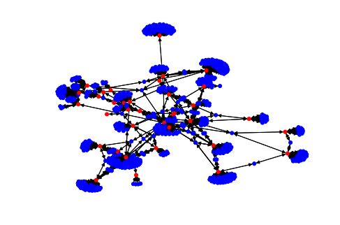
Red: authors
Blue: publications
Hop Distance: 3

Slide 34
Red: authors
Blue: publications
Hop Distance: 4

Slide 35
And now add the Citations (green)

Slide 36
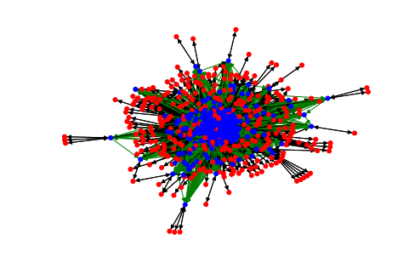
Red nodes: authors
Blue nodes: publications
Black edges: connection between author and his publications
Green edges: connection between publication and its cited publications

Slide 37
How can we solve distortion?
Since there is not a single answer
we tried to elaborate our personal theory
which could be reviewed empirically by
associating the weights of the edges in a different way

Slide 38
Self-citations
Re-Map edges assigning
0.5: for the first self-citation
0.25: for the second self-citation
0: for all subsequent self-citation
We decided not to use a negative measure as it could be too penalizing at a
"reputational" level
for the continuation of discoveries made by same author

Slide 39
exchanging citations
Re-Map edges assigning
1: for the first citation
Then check the dates of the other citations:
if the interval is less than 2 years
We reduce exponentially or proportionally
the weight we give to the edges of the following citations
It is possible also to include more complex conditions
like the university to which they belong to and/or the country where they operate in

Slide 40
conclusions
The sum of citations,
having no more unit weight
will certainly be lower than before
ranking the effective importance of an author in a more congruous way
Remapping the graph in this way we should be able to solve the two problems of distortion that we have detected and analyzed

Slide 41
Thanks for the attention!

